Slide 1
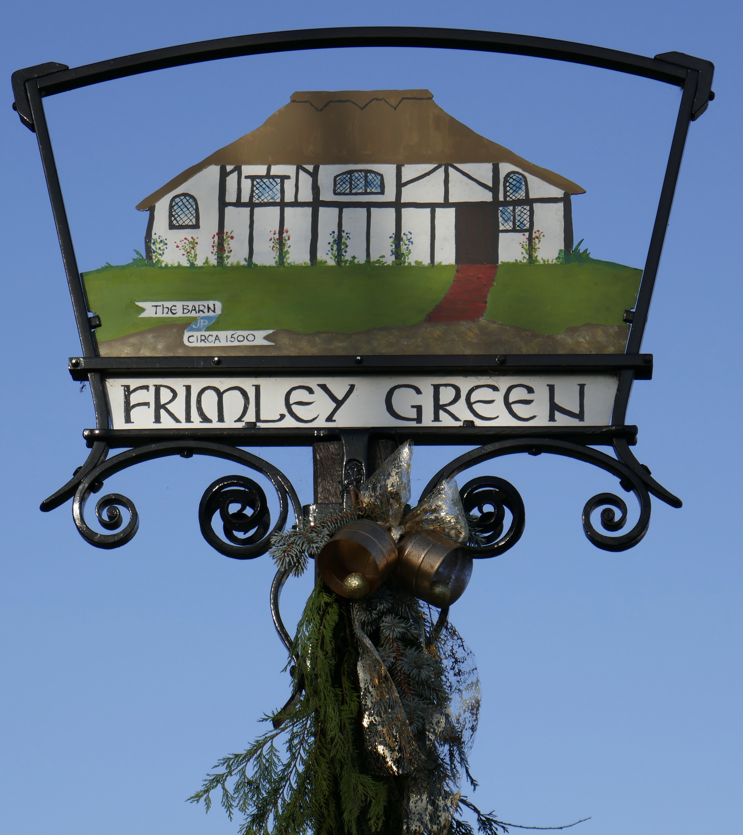
A Glimpse of Local History: Pictures of the Past
Mytchett, Frimley Green & Deepcut society
Graham O’Connell
Location photos courtesy of ©The Francis Frith Collection
Notes:
A short presentation of about 20 minutes showing a rather eclectic mix of photographs of local places and people with a story or two along the way.
For more on local history: https://mfgdsociety.org.uk/MFGDHistory.htm#Society

Slide 2
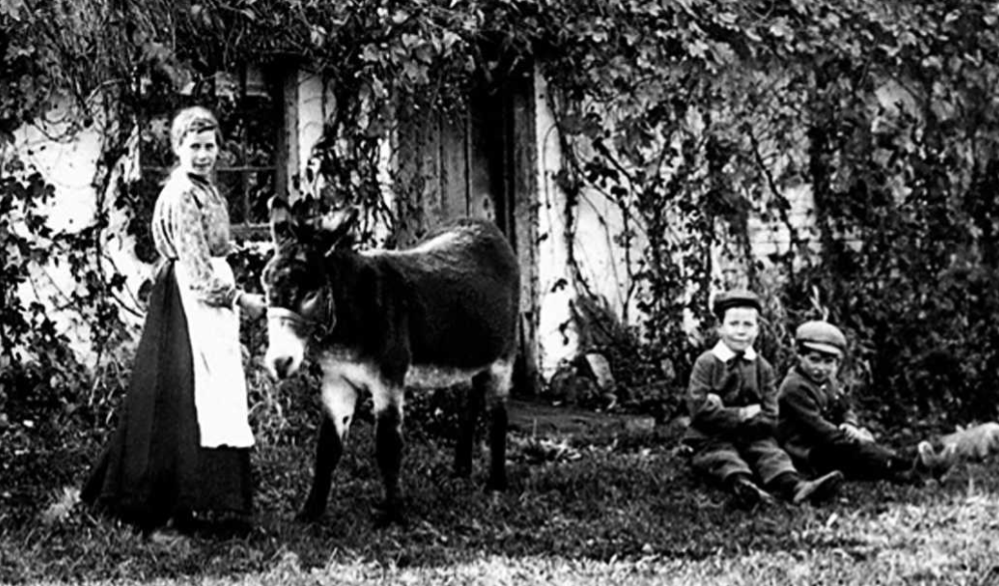
1906
Notes:
One of several donkeys in the area at the time. When planting a tree on the green we discovered an old donkey shoe. Could it be from this one? There were a lot of smallholders in the area who kept a mix of animals such as pigs and goats, but especially geese. Before we became Frimley Green, the common land at the centre of the village was called Gander Goose Green.

Slide 3
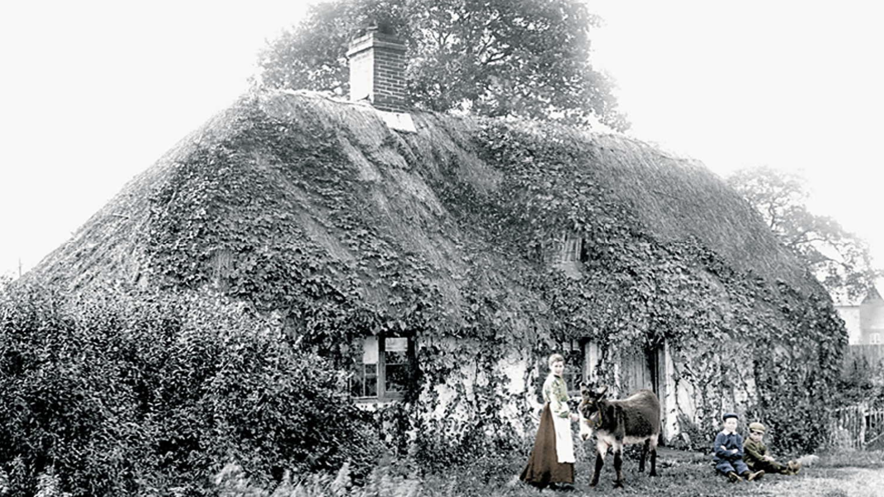
Thatched Cottage 1906
Notes:
Here is the same photo with the thatched cottage, Connemara, Bedfords Lane. The last family there were the Richardson’s. They were bricklayers and decided to knock down the old house, burn the thatch and build two new red brick houses.
Memories: https://www.francisfrith.com/uk/frimley-green/memories-of-bedford-lane_memory-230

Slide 4
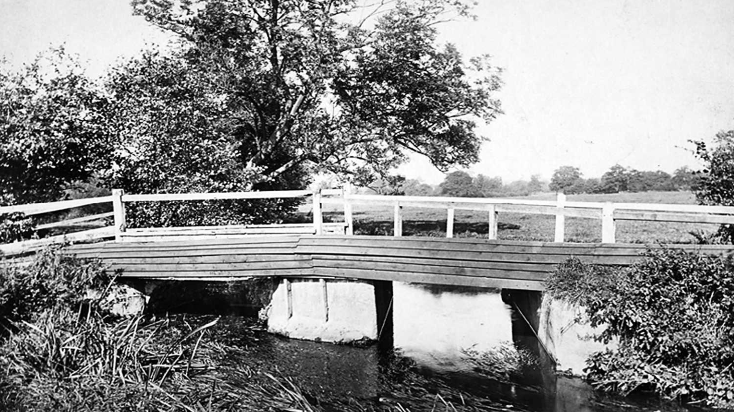
Hatches Bridge 1906
Notes:
The bridge crosses the Blackwater river giving access to Farnborough North. This bridge was re-built by Italian prisons of war in the 1940. The nearby fields had cattle and Shire horses before the gravel pits were excavated.

Slide 5
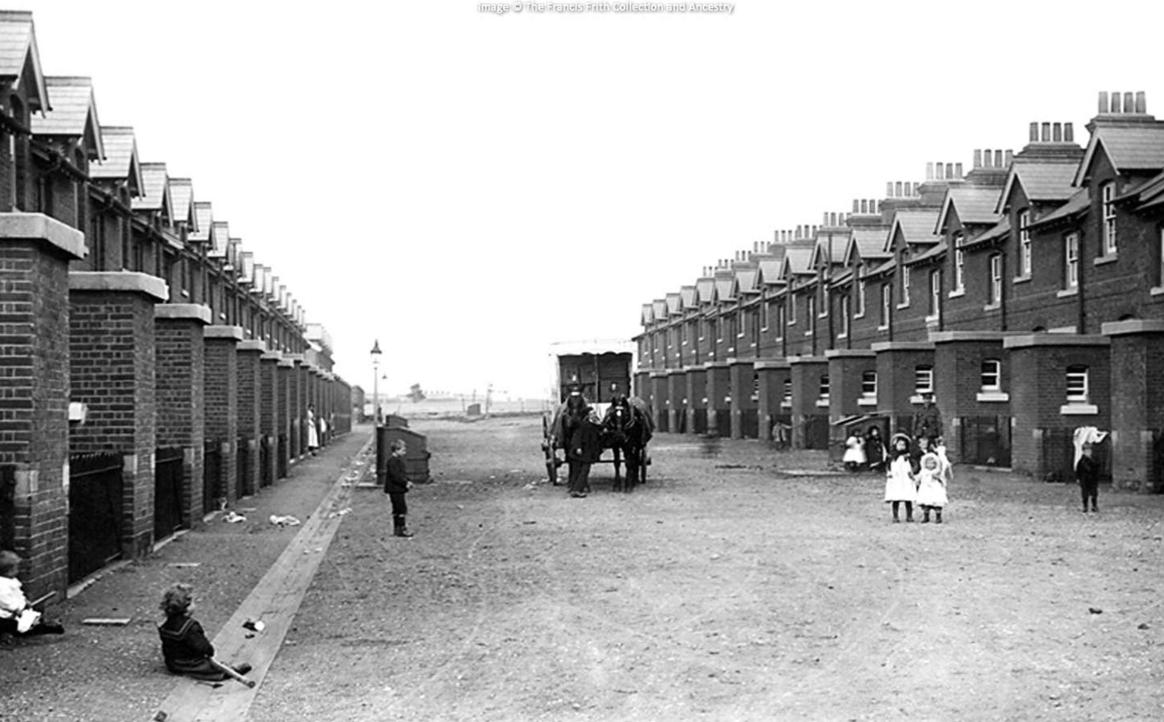
Blackdown Camp Married Quarters 1906
Notes:
Deepcut barracks was established by the Royal Engineers in late 1903 to accommodate artillery and infantry, centred on Winchester House, renamed Blackdown House when it was bought from the Pain family of Frimley Green by the War Office for military use. The terraced houses for soldiers were more modest but were modern by the standards of the day.
Memories: https://www.francisfrith.com/uk/deepcut/deepcut-blackdown-camp,-married-quarters-1906_55056

Slide 6
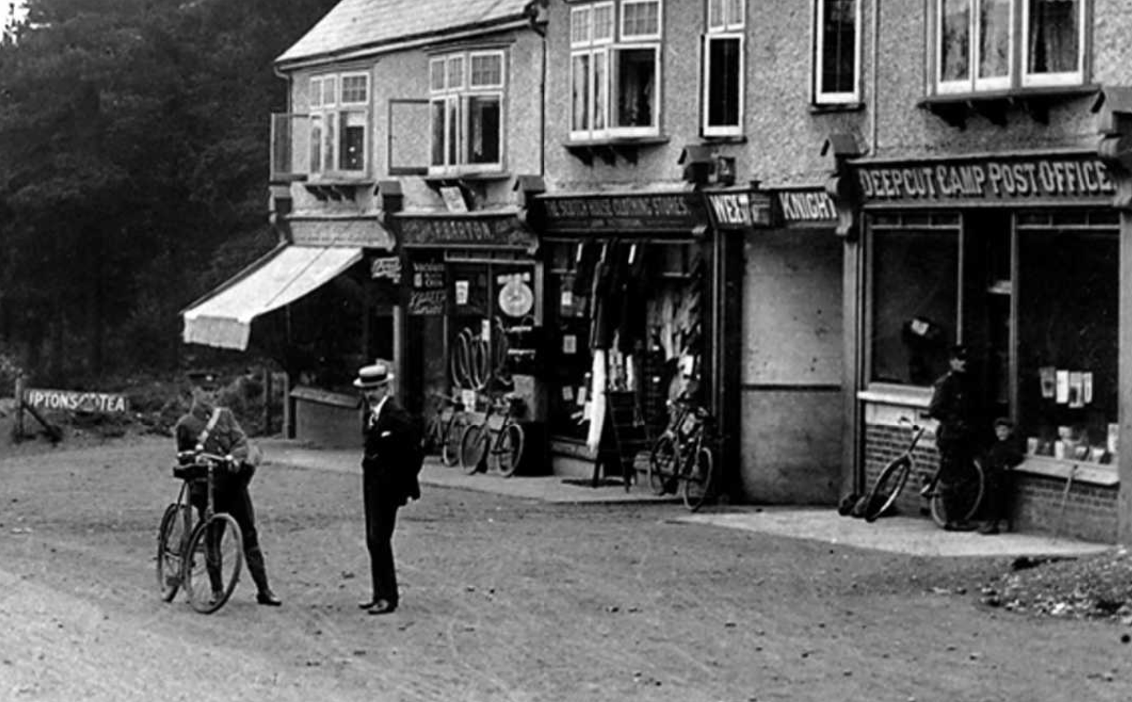
Deepcut 1908
Notes:
This scene was part of a postcard. Many were produced of the local area. Remember: no email or WhatsApp in those days! Note the bikes and cycle shop: we still have some way to go to raise the popularity of cycling to what it was 100 years ago.

Slide 7
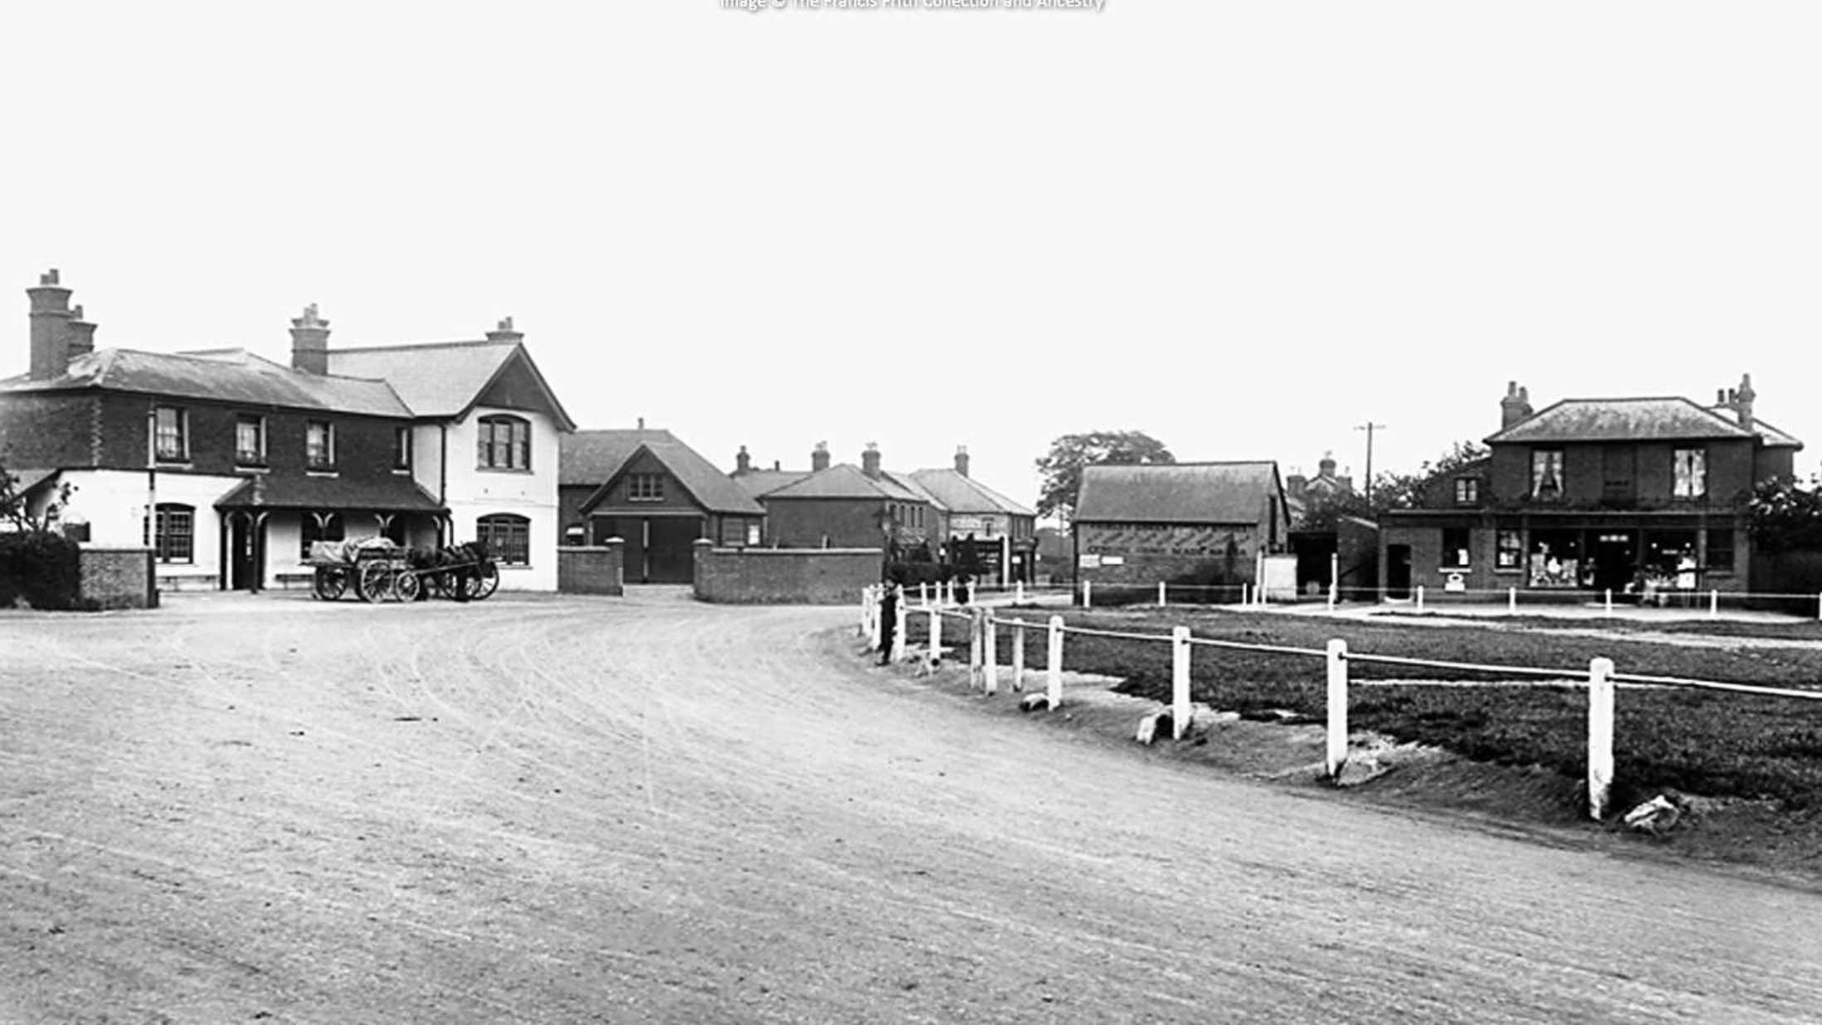
Frimley Green 1908
Notes:
A pretty wide road before the roundabouts - and the traffic was mostly horse drawn. There were stables at the Rose & Thistle pub as there were at most inns at the time. On the right there was a general store, later a Coop, where Grayderz hairdressers is now.
Village history: https://www.amazon.co.uk/Frimley-Village-History-Toynbee-Heather/dp/B001GOAQCQ

Slide 8
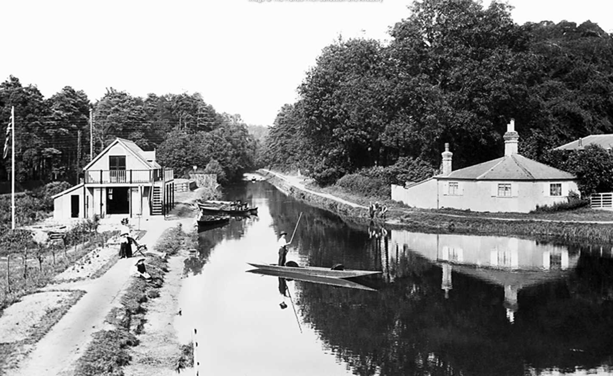
The Canal 1909
Notes:
Taken from the bridge over the canal on the Guildford Road. To the left is the boat house. In later years you could hire a small steam driven boat - about twice the size of a canoe - and in 1987 25,000 people came to the National Steam and Small boat Festival in Frimley lodge Park.
History of the canal: https://basingstoke-canal.org.uk/about/the-canal/history-of-the-canal/

Slide 9
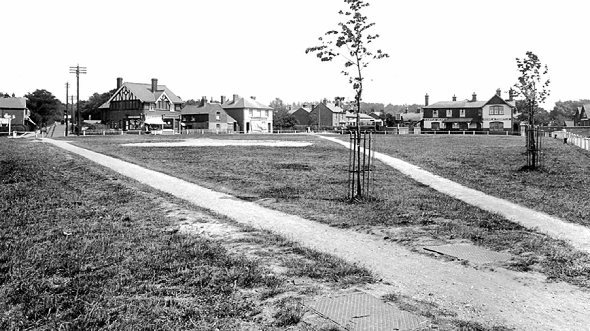
Village Green 1927
Notes:
Note the newly planted lime trees on this side of the green. The ones on the far side were not planted until the 1950s. Also spot the bare patch in the grass. The Warren family, from the garage, used to light the bonfire on the green every year.
Frimley Green: https://en.wikipedia.org/wiki/Frimley_Green

Slide 10
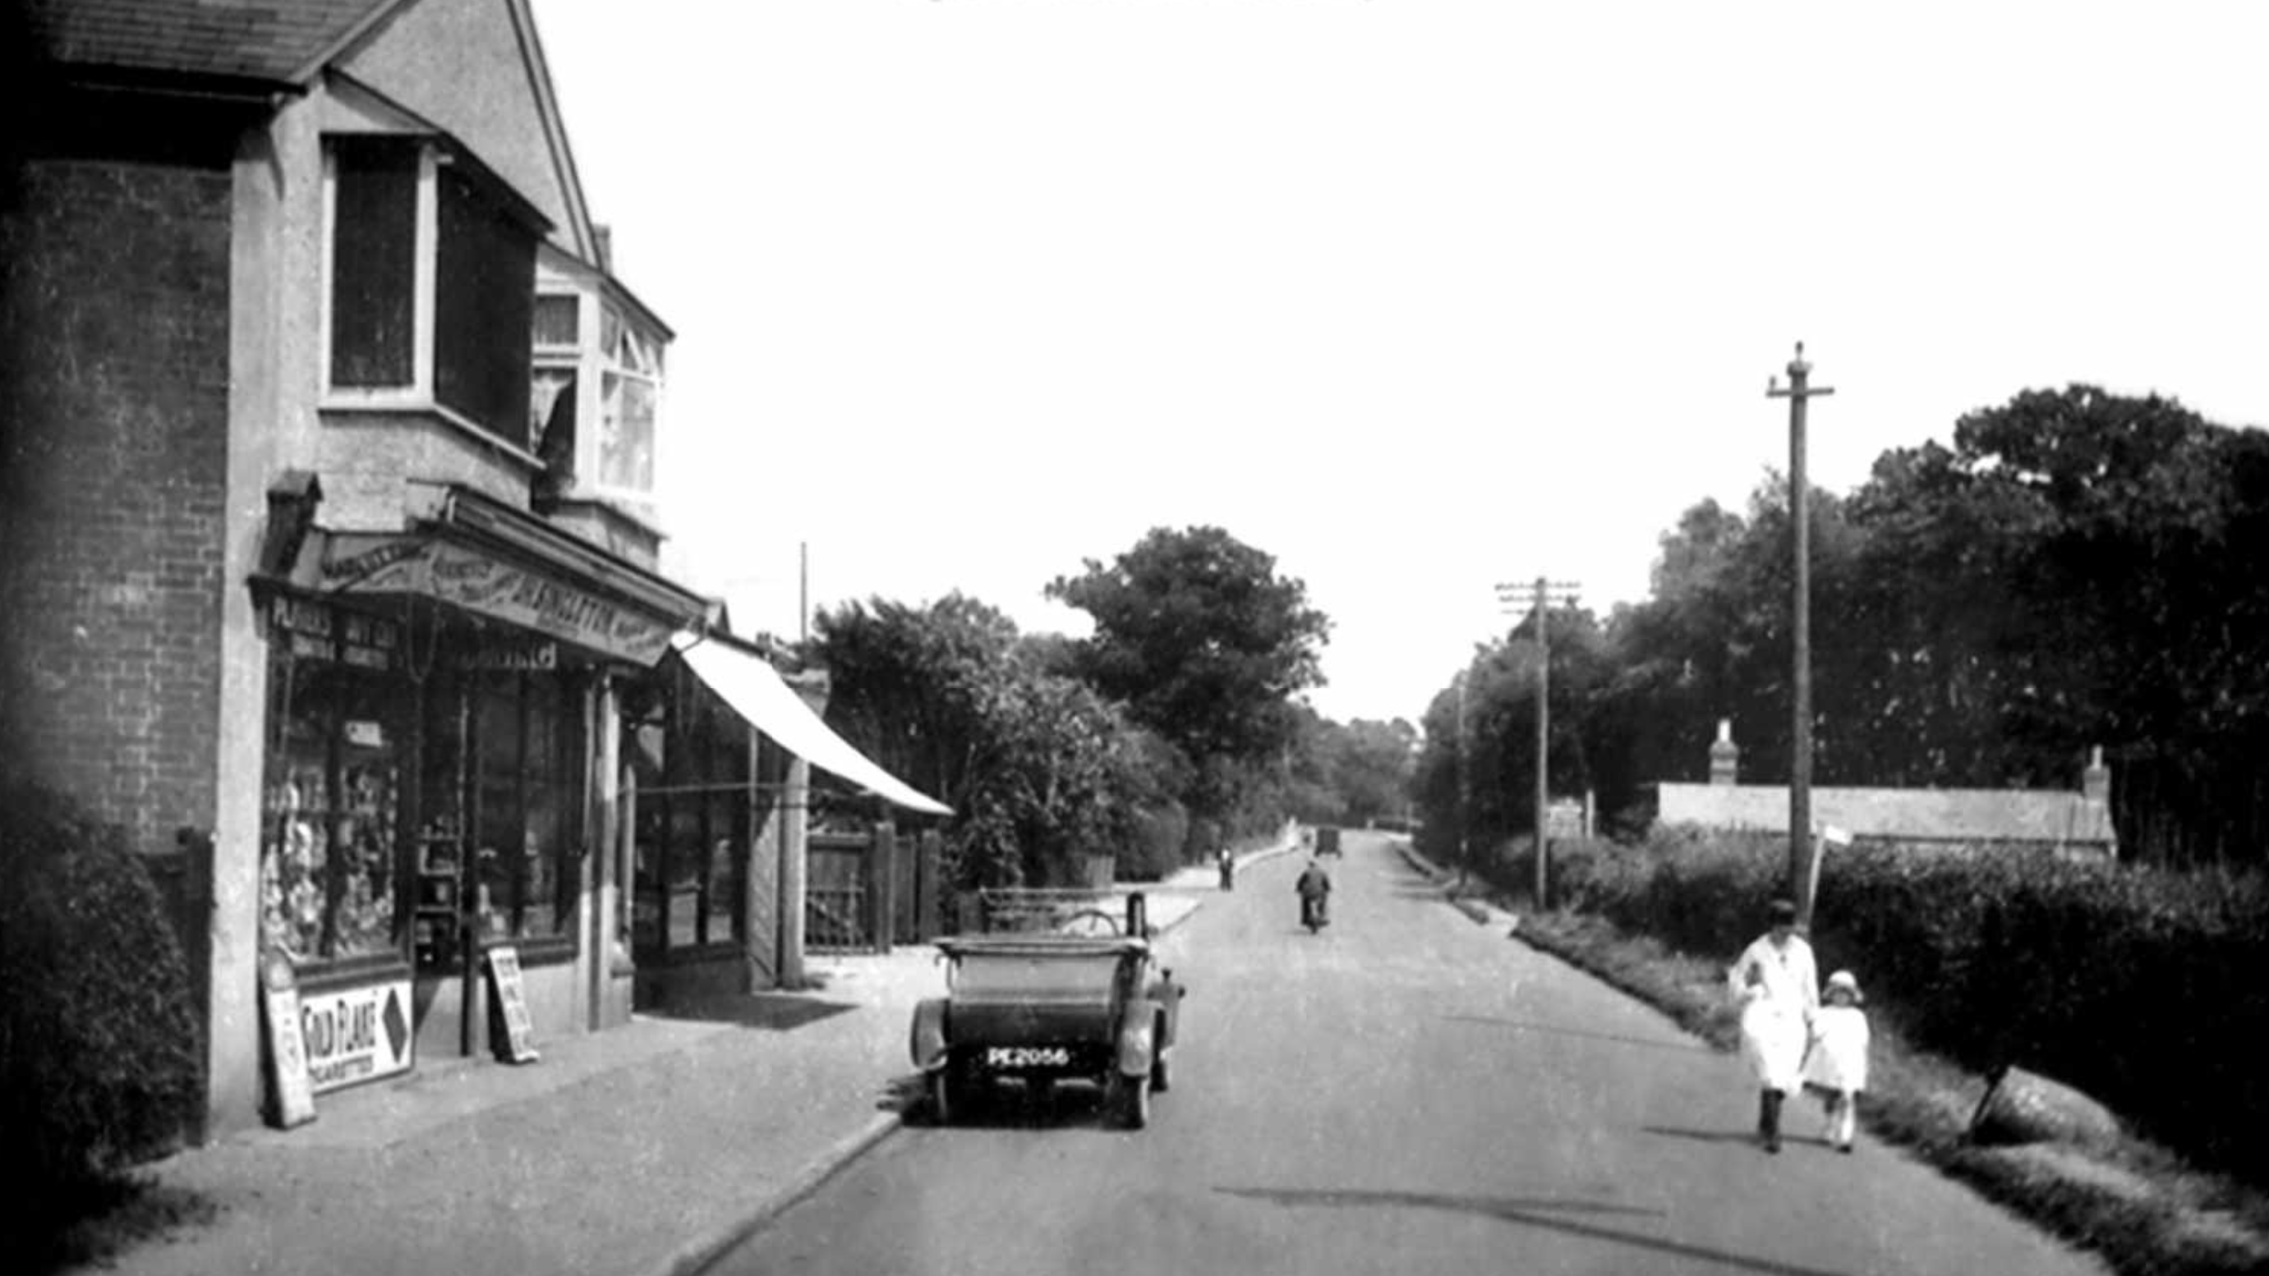
Wharf Road 1927
Notes:
The shop on the left is now the kite shop (just before Whoopee Motor Factors). The bungalow on the right is still there but there has been a lot of infill housing since then.

Slide 11
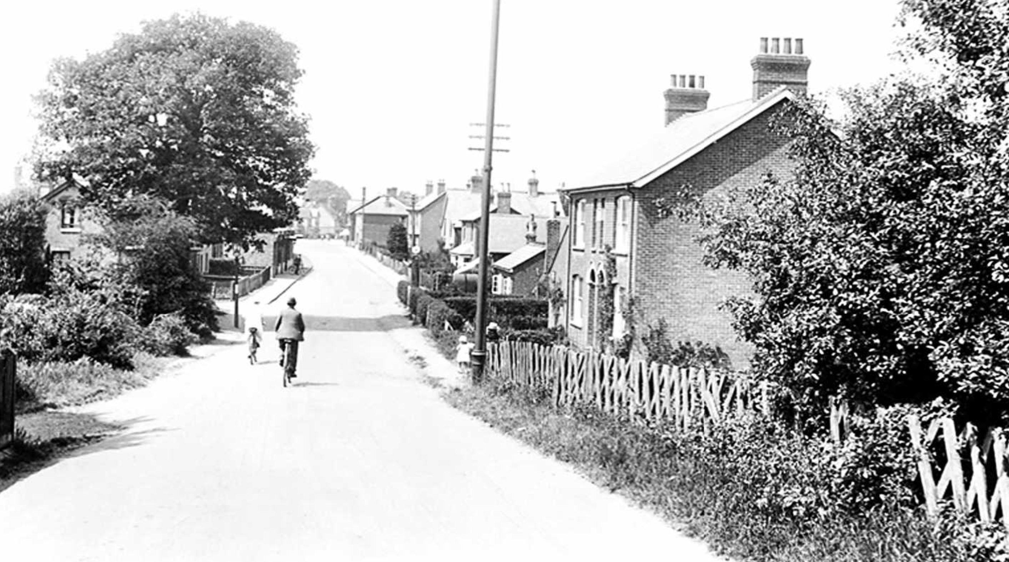
Guildford Road 1927
Notes:
A couple cycle down the slope from the railway bridge towards the green. Just a head of them on the right is Deeks’ workshop. On the left (just behind and out of shot) was the Railway Arms pub, with stabling for horses.
Visit Deeks’ Cycle shop: https://www.farnhamherald.com/article.cfm?id=119266&headline=Grand%20opening%20for%20restored%20bicycle%20shop&sectionIs=news&searchyear=2017

Slide 12
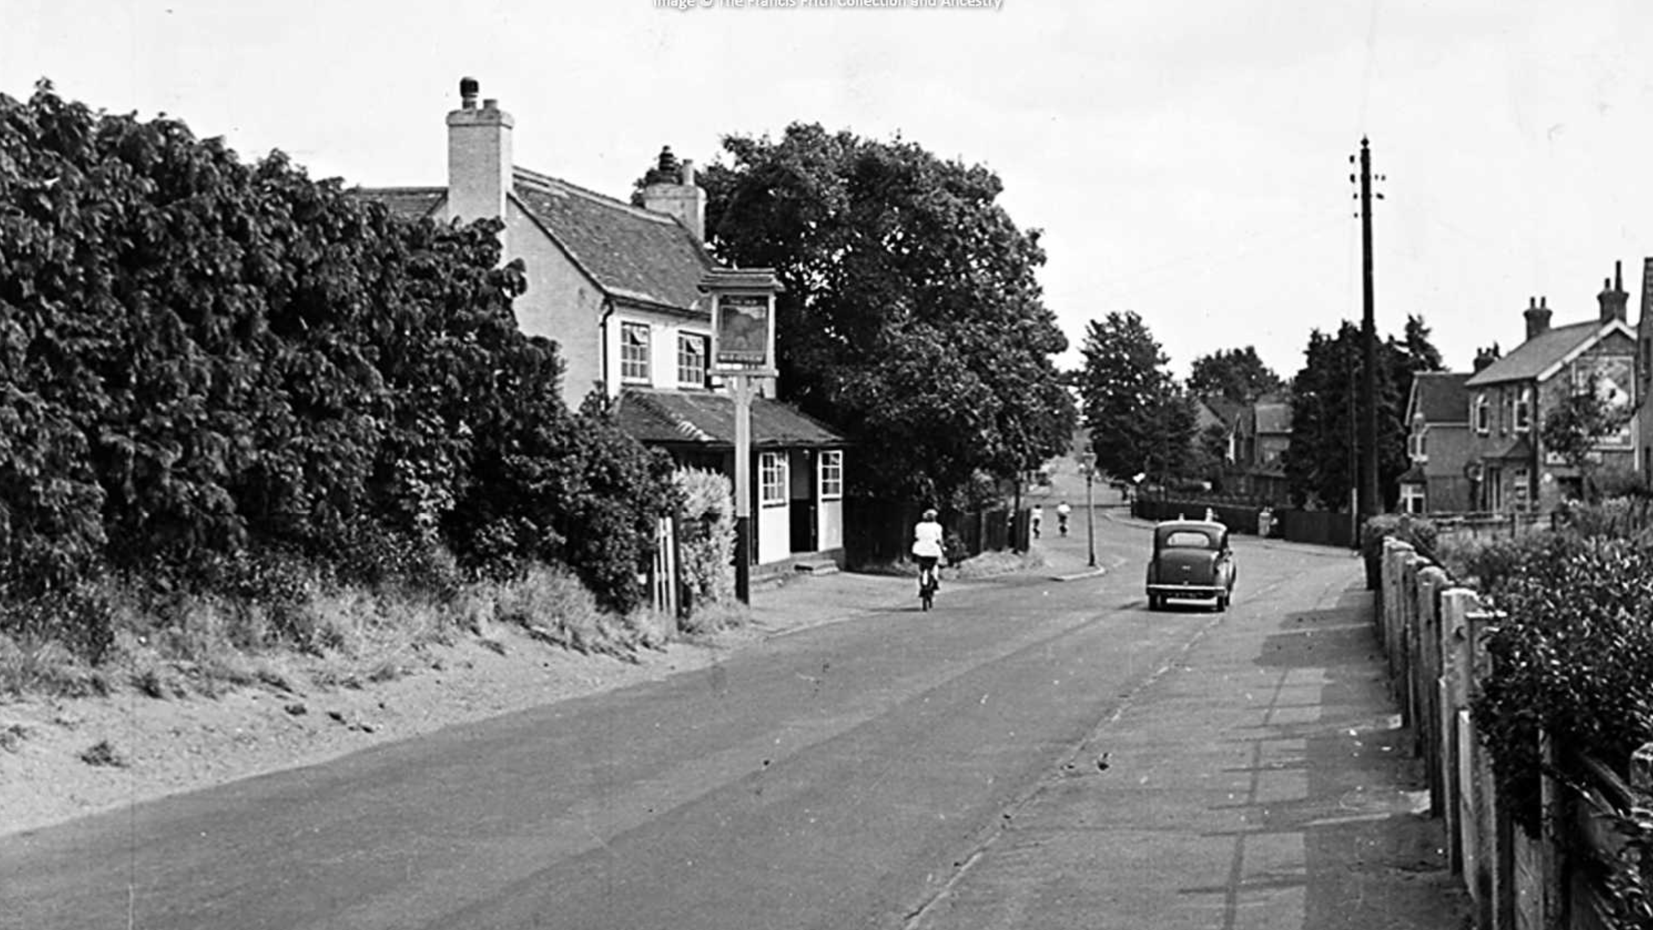
Old Wheatsheaf 1956
Notes:
The Old Wheatfsheaf in the days when there were two bars. On the left and behind the pub was the old nursery. Plant growing was big in this area around this time. Incidentally there was another Wheatsheaf pub further down on the left.
Early publicans: https://pubwiki.co.uk/SurreyPubs/Frimley/OldWheatsheaf.shtml

Slide 13
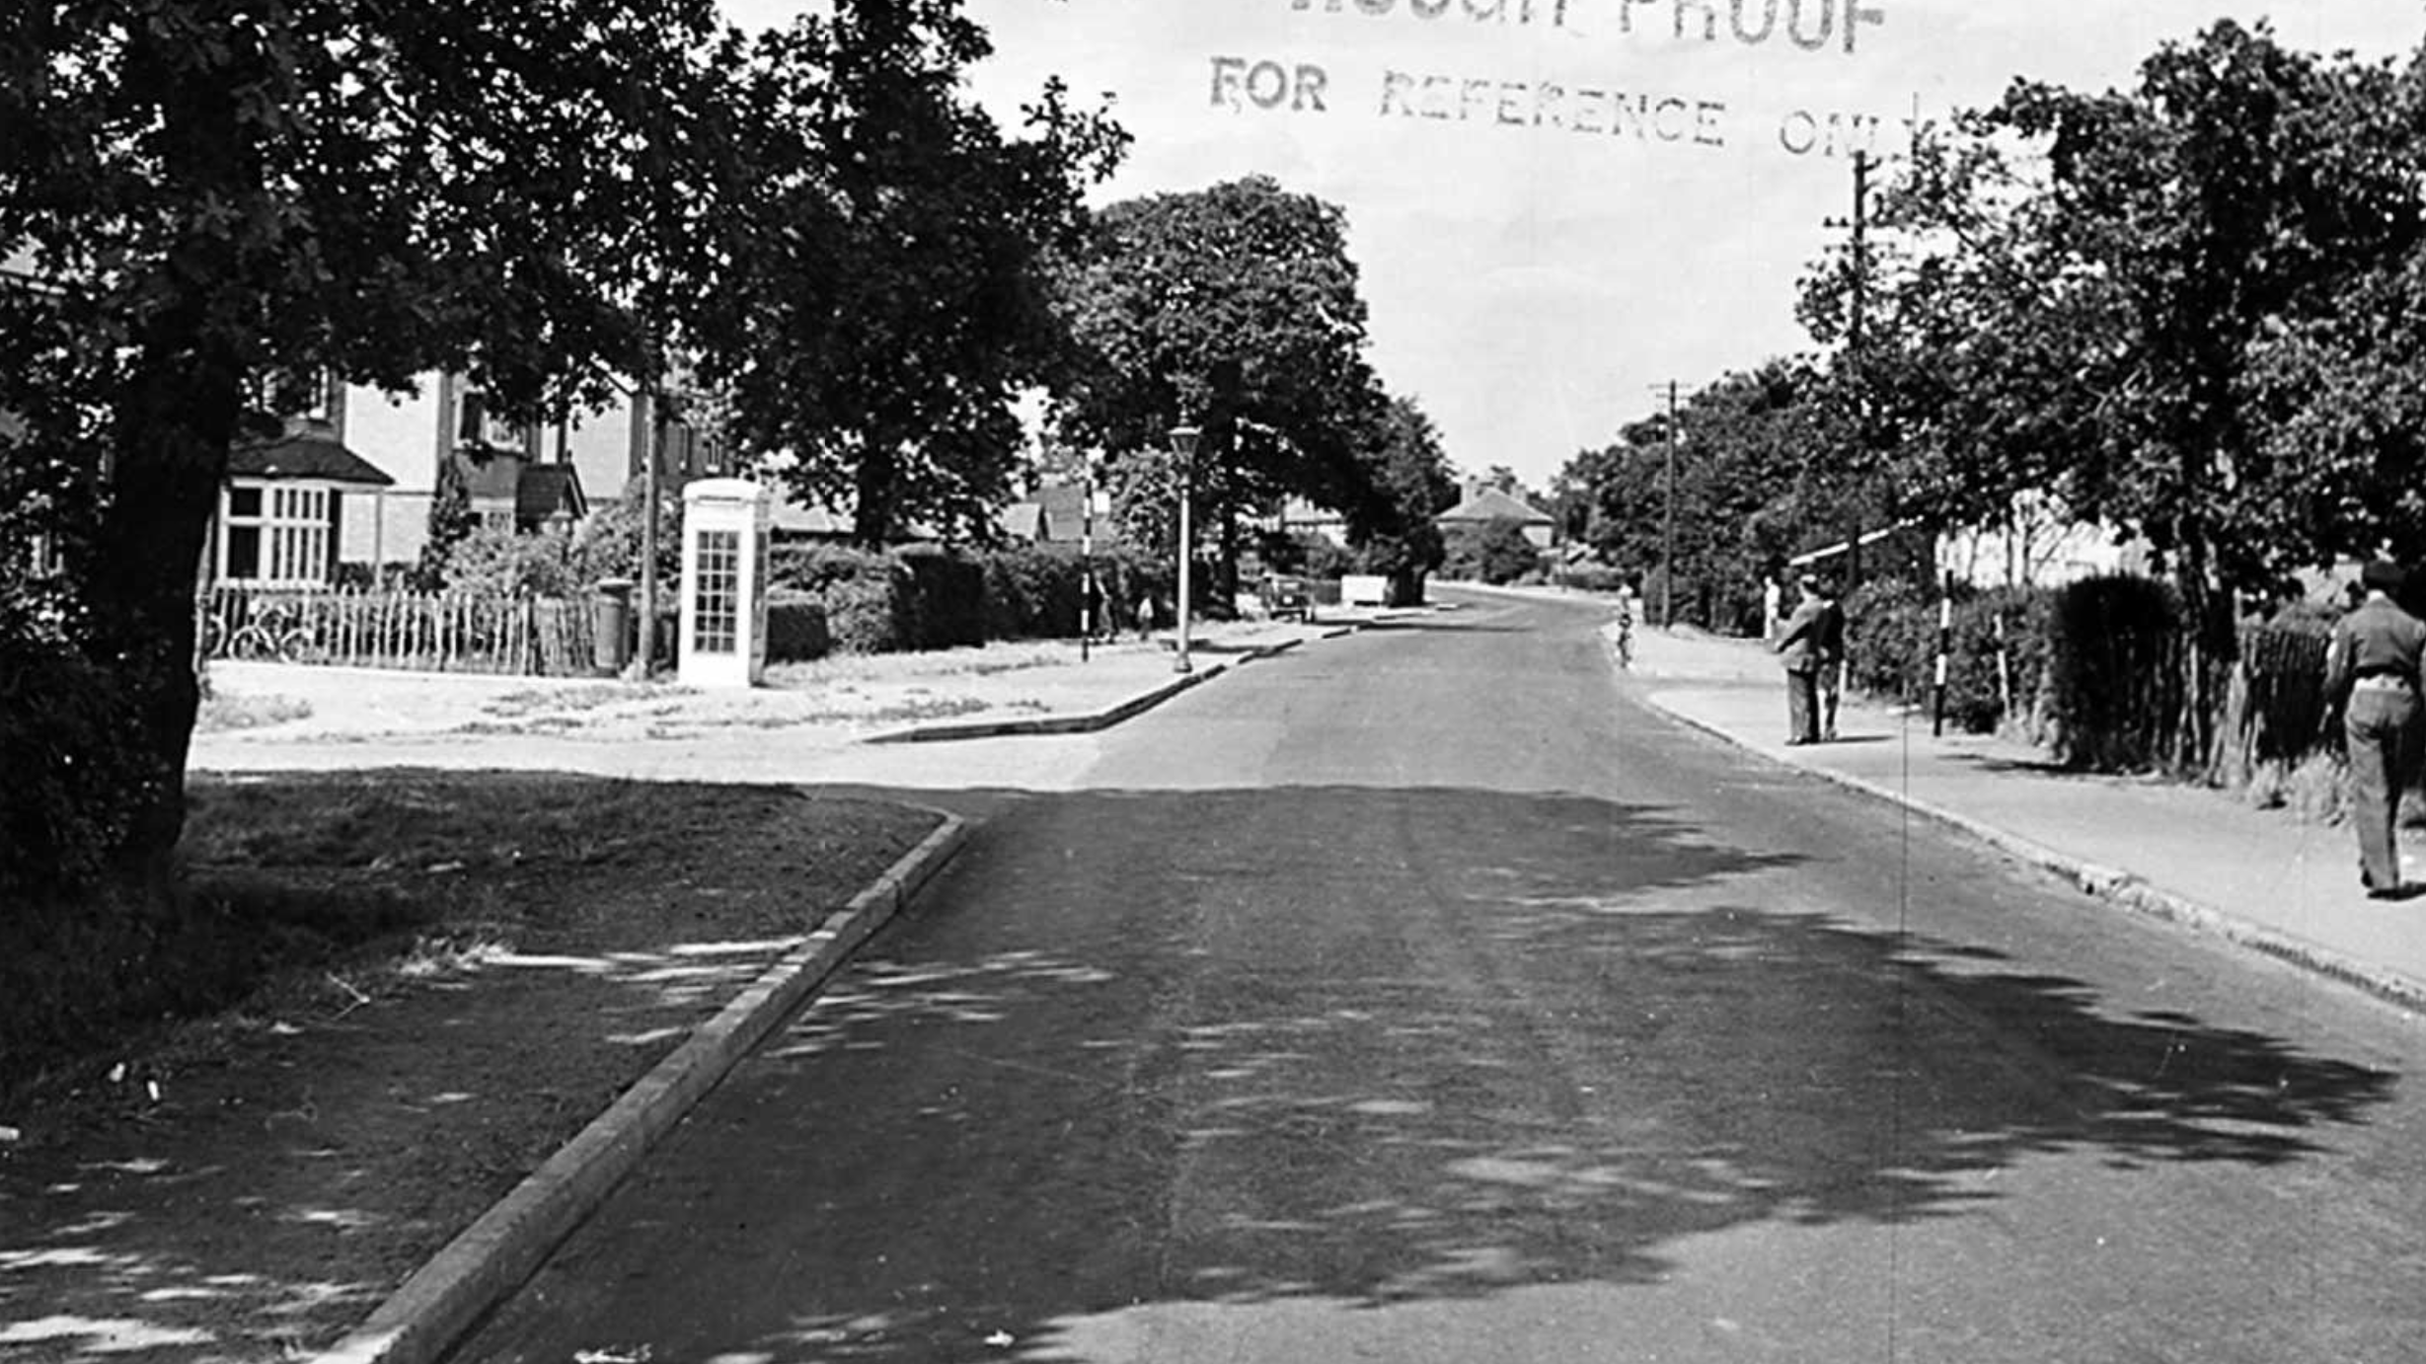
Mytchett 1955
Notes:
Taken from Mytchett looking up Sturt Road towards the Miners Arms. Beyond and over the bridge was the home of Sooty (now a scaffolding site). Incidentally, ever wondered why it is called Sturt Road? It is named after local author George Sturt (from Farnham) who wrote about rural crafts and country life.
More about Mytchett: https://www.francisfrith.com/uk/mytchett

Slide 14
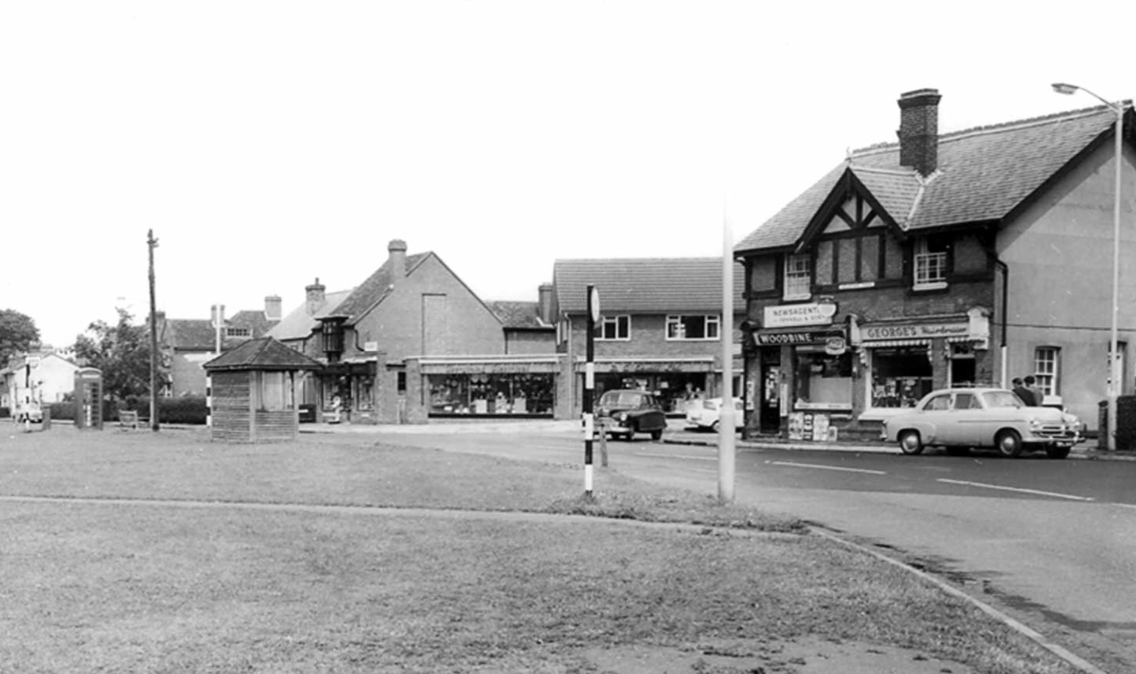
Frimley Green 1965
Notes:
Note the old bus stop (the almost identical replacement is now further along). Ensoll’s electrical lighting shop is the centre of the picture on the corner. George’s barbers on the right.

Slide 15
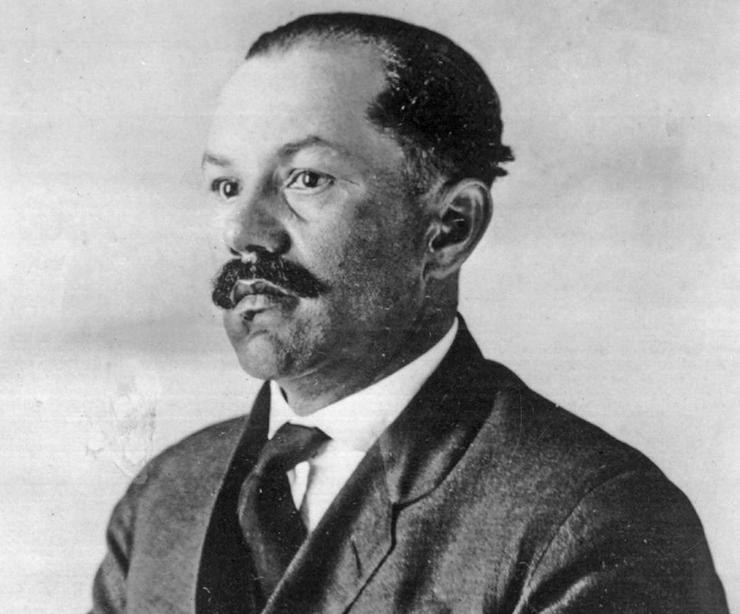
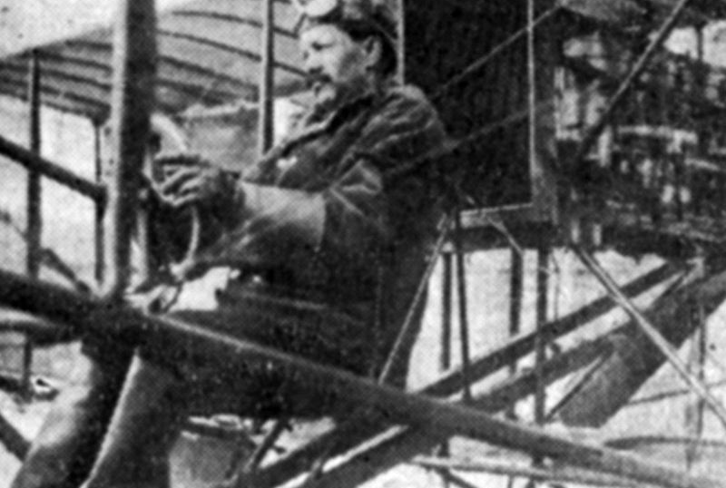
Lucean Arthur Headen:
Pilot, Inventor & Entrepreneur
Photo Courtesy National Archives
Notes:
Born in the South of the USA. By 1931, Headen was was divorced and was eager to return to England where he was recognised simply as an inventor—not “a Negro inventor”. He lived firstly in Camberley then Frimley Green (Beech Road) for the next 30 years until his death in 1957.
USA: Flying demonstrations, car racing & car manufacturing
UK: Engineering firm in Camberley
Inventions: in 1917, Headen invented a cloaking device for submarine chasers. (The ship’s hull would be fitted with angled mirrors that would reflect images of the sky and water to anyone observing the vessel). De-icing plane wings with heated air. Car & lorry gasket designed to protect engines from damage caused by unburned fuel.
Full story: https://www.exploringsurreyspast.org.uk/themes/subjects/black_history/lucean-arthur-headen-an-african-american-inventor-in-camberley/
And: https://www.surreycc.gov.uk/culture-and-leisure/history-centre/marvels/lucean-arthur-headen-an-african-american-inventor-in-camberley

Slide 16
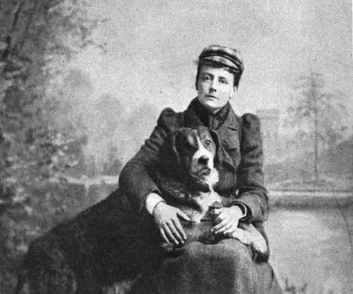
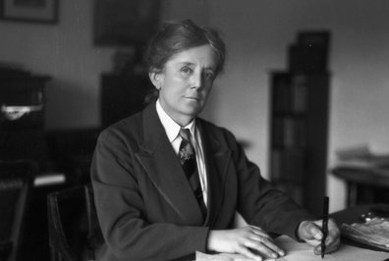
Dame Ethel Smyth:
Composer, suffragette, sportswoman
Photos Courtesy Museum of London
Notes:
Ethel Smyth (1858 - 1944) moved to Frimhurst aged 9. She studied at the Leipzig Conservatory where she met composers including Grieg, Tchaikovsky, Clara Schumann and Brahms. Among her most famous works are the opera The Wreckers and her Mass in D.
In 1911 she wrote ‘The March of the Women’, dedicated to Emmeline Pankhurst. It became the official anthem of the Women’s Social and Political Union. She worked as a radiographer in a military hospital in WW1. Photo with dog Marco.
Full story: https://www.exploringsurreyspast.org.uk/themes/people/musicians/dame_ethel_smyth/
Frimhurst: https://www.frimhurstenterprises.org.uk/history-of-the-house/

Slide 17
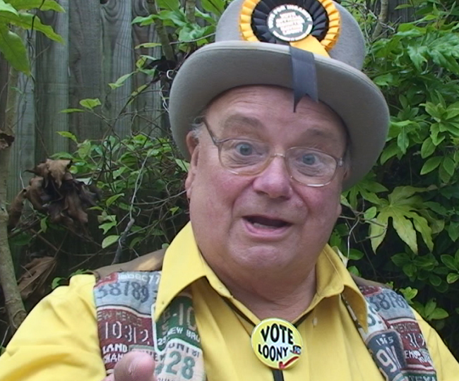
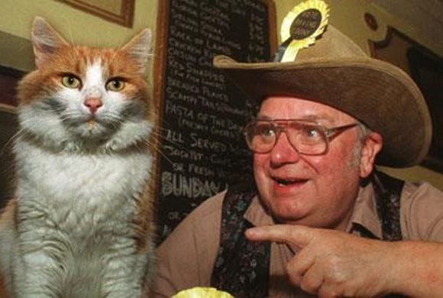
Catmando:
Political party leader and bird catcher; born in Mytchett
Howling ‘Laud’ Hope & Catmando Photos Courtesy Monster Raving Party
Notes:
Catmando (1995-2002), Mytchett. The Monster Raving Loony Party Pet Cat. At the conference of 1999 when the “election” came up for the new leader, it was a two sided race between Howling ‘Laud’ Hope and Catmando. The voting was very close, they got 112 votes each. It was decided that they should both become Joint Leaders: the first political party to be ruled by man and beast. Catmando took on a lorry in 2002 and sadly came off second best.
Full story: https://en.wikipedia.org/wiki/Catmando

Slide 18
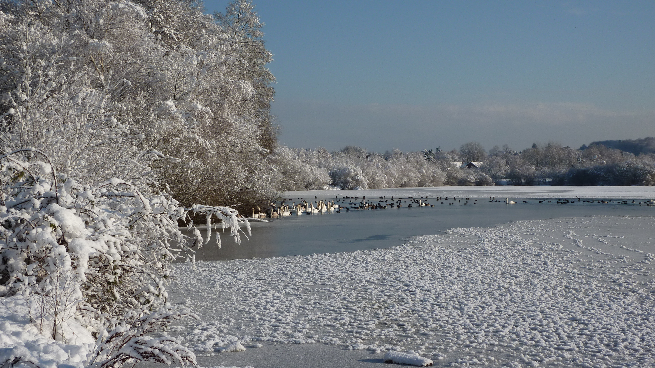
Hatches Lake
Notes:
A more recent scene to end on - snow at The Hatches lake, looking back to Frimley Green - reminding us that although much has changed we still live in a beautiful area.
For more on local history: https://mfgdsociety.org.uk/MFGDHistory.htm#Society
Any pics or stories to share do let us know.

